Slide 1
The Gog-Magog War – Ezekiel 39
The End-Time Battle for Israel

Slide 2
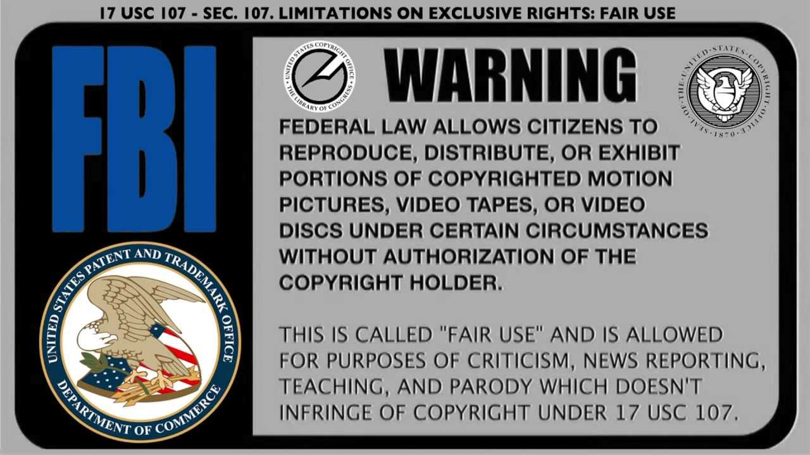

Slide 3
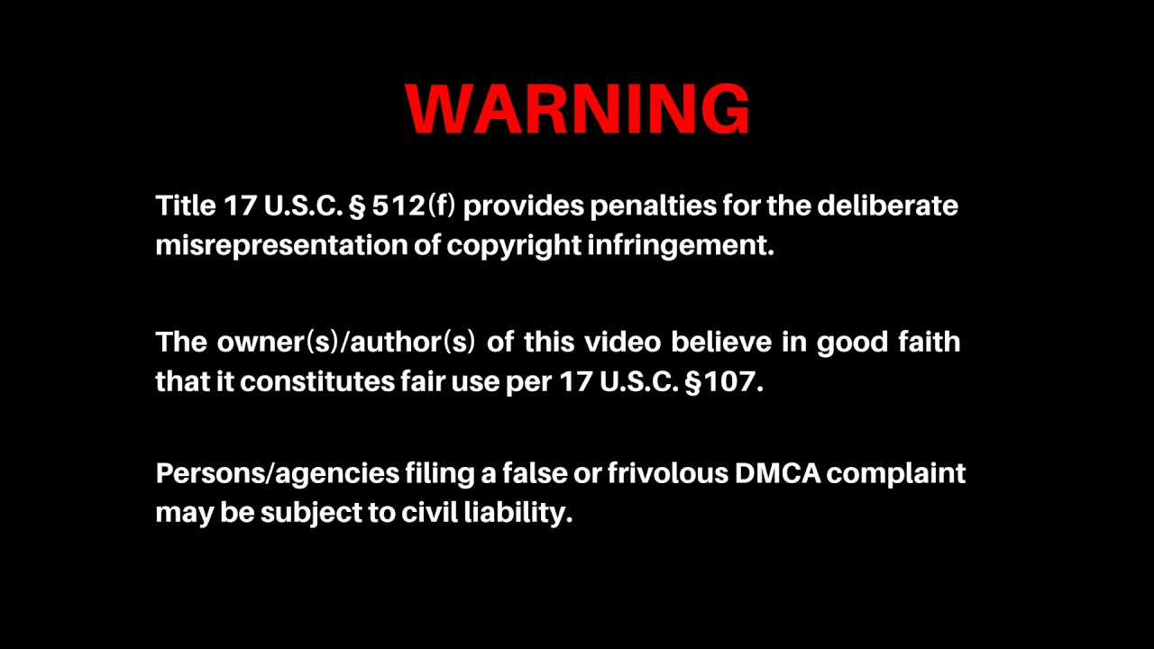

Slide 4
The Gog-Magog War – Ezekiel 39
We saw from Ezekiel 38 that the players in this war are:
  The Revived Ottoman Empire (Turkey)
  Persia (Iran)
  The Renegade Members of the Tribe of Reuben (Scattered to the Nations)
  The Tribes of North Africa
  Various Balkan Countries (Bosnia, Herzegovnia, Kosovo)
What do they want?
  The Gas Fields off the coast of Israel
  Israel’s Defense Technologies

Slide 5
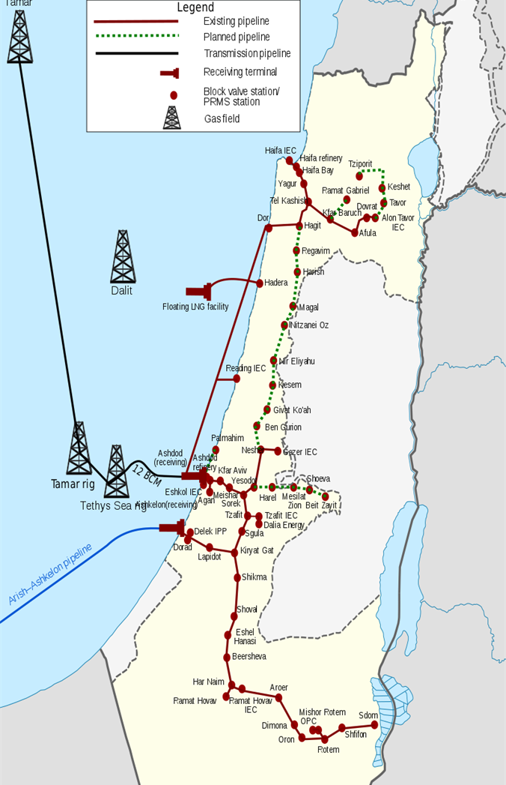
The Gog-Magog War – Ezekiel 39
There are three natural gas fields off the Israeli coast:
  Dalit
  Tamar
  Tetty’s Sea Rig
Estimates of the value of these gas fields range at about one trillion dollars!
It should be noted that if they can take them over, the Seven Royal Families will be more than happy to exploit them, just like they have done in Iran, Kuwait, United Arab Emirates, Qatar, and Saudi Arabia.
Like usual, if the Arabs will do the dirty work, the royal families will be more than happy to exploit the situation. That’s why they pushed the vaccines in Israel, but NOT in any Islamic country!

Slide 6
The Gog-Magog War – Ezekiel 39
We saw from Ezekiel 38 that the players in this war are:
  What the Arabs do not realize is that YHWH has a purpose with this battle.
  He wants to make himself known to the Arab nations.
  He wants them to give up worship of their “Moon” elohim and worship the Creator of the Universe.
  He will draw them into this battle, they will not go willingly.
  This war is different from the Revelation 20 battle, which is Post-Millennium. There, the devil (driven by Ancient Evil) will incite Gog-Magog to convince the rest of the world to go against Israel. It will be at this time when the devil and all evil will be cast into the Lake of Fire for all of eternity.

Slide 7
The Gog-Magog War – Ezekiel 39
We saw from Ezekiel 38 that the players in this war are:
  What the Arabs do not realize is that YHWH has a purpose with this battle.
  He wants to make himself known to the Arab nations.
  He wants them to give up worship of their “Moon” elohim and worship the Creator of the Universe.
  He will draw them into this battle, they will not go willingly.
  This war is different from the Revelation 20 battle, which is Post-Millennium. There, the devil (driven by Ancient Evil) in incite Gog-Magog to convince the rest of the world to go against Israel. It will be at this time when the devil and all evil will be cast into the Lake of Fire for all of eternity.

Slide 8
The Gog-Magog War
Ezekiel 39
  Therefore, thou son of man, prophesy against Gog, and say, Thus saith the Master YHWH; Behold, I am against thee, O Gog, the chief prince of Meshech and Tubal:
  And I will turn thee back, and leave but the sixth part of thee, and will cause thee to come up from the north parts, and will bring thee upon the mountains of Israel:
  And I will smite thy bow out of thy left hand, and will cause thine arrows to fall out of thy right hand. (Ezekiel 39:1-3)

Slide 9
The Gog-Magog War
Gog
  Hebrew גּוג (Strong’s #1463) “mountain”
    The sons, I say, of Reuben the firstborn of Israel were, Hannoch, and Pallu, Hezron, and Carmi.
    The sons of Joel; Shemaiah his son, Gog his son, Shimei his son, Micah his son, Reaia his son, Baal his son,
    Beerah his son, whom Tilgath-pilneser king of Assyria carried away captive: he was prince of the Reubenites. (I Chronicles 5:3-6)

Slide 10
The Gog-Magog War
Gog
  Hebrew גּוג (Strong’s #1463) “mountain”
    Now the sons of Reuben the firstborn of Israel, (for he was the firstborn; but, forasmuch as he defiled his father's bed, his birthright was given unto the sons of Joseph the son of Israel: and the genealogy is not to be reckoned after their birthright.
    For Judah prevailed above his brethren, and of him came the chief ruler; but the birthright was Joseph's:) (I Chronicles 5:1-2)
      And it came to pass, when Israel dwelt in that land, that Reuben went and lay with Bilhah his father's concubine: and Israel heard it… (Genesis 35:22a)
      Could there be some resentment in the House of Reuben over losing their birthright and leadership to the Houses of Joseph and Judah?

Slide 11
The Gog-Magog War
Meshech
  Hebrew משׁך (Strong’s #4902) “drawing out”
    The sons of Japheth; Gomer, and Magog, and Madai, and Javan, and Tubal, and Meshech, and Tiras. (Genesis 10:2, I Chronicles 1:5)
    The sons of Shem; Elam, and Asshur (Assyria), and Arphaxad, and Lud, and Aram (Syria), and Uz, and Hul, and Gether, and Meshech. (I Chronicles 1:17)
    Woe is me, that I sojourn in Mesech, that I dwell in the tents of Kedar! (Psalms 120:5)

Slide 12
The Gog-Magog War
Meshech
  Hebrew משׁך (Strong’s #4902) “drawing out”
    Javan, Tubal, and Meshech, they were thy merchants: they traded the persons (souls) of men and vessels of brass in thy market. (Ezekiel 27:13)
      Ezekiel 27 can be compared with Revelation 18, as they both discuss world commerce in the end times. The city of Tyre is the capital of Phoenicia, it was the trading center of the ancient world.
      Phoenicia started the cities of Greece (Javan), Carthage, and Rome. They were the first country to bring about world trade.

Slide 13
The Gog-Magog War
Meshech
  Hebrew משׁך (Strong’s #4902) “drawing out”
    There is Meshech, Tubal, and all her multitude: her graves are round about him: all of them uncircumcised, slain by the sword, though they caused their terror in the land of the living.
    And they shall not lie with the mighty that are fallen of the uncircumcised, which are gone down to hell with their weapons of war: and they have laid their swords under their heads, but their iniquities shall be upon their bones, though they were the terror of the mighty in the land of the living.
    Yea, thou shalt be broken in the midst of the uncircumcised, and shalt lie with them that are slain with the sword. (Ezekiel 32:26-28)
      Notice that Javan (Greece) is missing from this prophecy?
      Some authors have suggested this to be at least part of the Ottoman Empire.

Slide 14
The Gog-Magog War
Tubal
  Hebrew: תּבל / תּוּבל (Strong’s #8422) “thou shall be brought”
    The sons of Japheth; Gomer, and Magog, and Madai, and Javan, and Tubal, and Meshech, and Tiras. (Genesis 10:2)
    The sons of Japheth; Gomer, and Magog, and Madai, and Javan, and Tubal, and Meshech, and Tiras. (I Chronicles 1:5)

Slide 15
The Gog-Magog War
Tubal
  Hebrew: תּבל / תּוּבל (Strong’s #8422) “thou shall be brought”
    And I will set a sign among them, and I will send those that escape of them unto the nations, to Tarshish, Pul, and Lud, that draw the bow, to Tubal, and Javan (Greece), to the isles afar off, that have not heard my fame, neither have seen my glory; and they shall declare my glory among the Gentiles. (Isaiah 66:19)
      Interesting prophecy of where people will go to proclaim what has happened in Israel in the beginning of the Millennial Kingdom.

Slide 16
The Gog-Magog War
Tubal
  Hebrew: תּבל / תּוּבל (Strong’s #8422) “thou shall be brought”
    And Zillah, she also bare Tubal-cain, an instructer of every artificer in brass and iron: and the sister of Tubal-cain was Naamah. (Genesis 4:22)
    Javan, Tubal, and Meshech, they were thy merchants: they traded the persons (souls) of men and vessels of brass in thy market. (Ezekiel 27:13)
      Why is brass so important?
      These three countries deal in “souls of men.” This suggests some kind of occult activity to extract souls so they can be sold.
      Javan = Greece… missing from Ezekiel 38-39… why?

Slide 17
The Gog-Magog War
Tubal
  Hebrew: תּוּבל קין (Strong’s #8422) “thou will be brought of Cain”
    And Zillah, she also bare Tubal-cain, an instructer of every artificer in brass and iron: and the sister of Tubalcain was Naamah. (Genesis 4:22)
      Instructer = to sharpen, hammer, whet
      Artificer = metal craftsman
      A descendant of Cain, son of Lamech, the second murderer.
      Cain’s sons were the first to build cities.
      Could there be Nephilim blood in Tubalcain?

Slide 18
The Gog-Magog War
Tubal
  Hebrew: תּבל / תּוּבל (Strong’s #8422) “thou shall be brought”
    There is Meshech, Tubal, and all her multitude: her graves are round about him: all of them uncircumcised, slain by the sword, though they caused their terror in the land of the living.
    And they shall not lie with the mighty that are fallen of the uncircumcised, which are gone down to hell with their weapons of war: and they have laid their swords under their heads, but their iniquities shall be upon their bones, though they were the terror of the mighty in the land of the living.
    Yea, thou shalt be broken in the midst of the uncircumcised, and shalt lie with them that are slain with the sword. (Ezekiel 32:26-28)

Slide 19
The Gog-Magog War
Ezekiel 39
  Thou shalt fall upon the mountains of Israel, thou, and all thy bands, and the people that is with thee: I will give thee unto the ravenous birds of every sort, and to the beasts of the field to be devoured.
  Thou shalt fall upon the open field: for I have spoken it, saith the Master YHWH. (Ezekiel 39:4-5)

Slide 20
The Gog-Magog War
  Now Look at New Testament Prophecy:
  And I saw an angel standing in the sun; and he cried with a loud voice, saying to all the fowls that fly in the midst of heaven, Come and gather yourselves together unto the supper of the great Elohim;
  That ye may eat the flesh of kings, and the flesh of captains, and the flesh of mighty men, and the flesh of horses, and of them that sit on them, and the flesh of all men, both free and bond, both small and great. (Revelation 19:17-18)

Slide 21
The Gog-Magog War
Ezekiel 39
  And I will send a fire on Magog, and among them that dwell carelessly in the isles: and they shall know that I am YHWH.
  So will I make my holy name known in the midst of my people Israel; and I will not let them pollute my holy name any more: and the heathen shall know that I am YHWH, the Holy One in Israel. (Ezekiel 39:6-7)

Slide 22
The Gog-Magog War
Ezekiel 39
  And they that dwell in the cities of Israel shall go forth, and shall set on fire and burn the weapons, both the shields and the bucklers, the bows and the arrows, and the handstaves, and the spears, and they shall burn them with fire seven years:
  So that they shall take no wood out of the field, neither cut down any out of the forests; for they shall burn the weapons with fire: and they shall spoil those that spoiled them, and rob those that robbed them, saith the Master YHWH. (Ezekiel 39:9-10)

Slide 23
The Gog-Magog War
Ezekiel 39
  And it shall come to pass in that day, that I will give unto Gog a place there of graves in Israel, the valley of the passengers on the east of the sea: and it shall stop the noses of the passengers: and there shall they bury Gog and all his multitude: and they shall call it The valley of Hamon-gog.
  And seven months shall the house of Israel be burying of them, that they may cleanse the land.
  Yea, all the people of the land shall bury them; and it shall be to them a renown the day that I shall be glorified, saith the Master YHWH. (Ezekiel 39:11-13)

Slide 24
The Gog-Magog War
Ezekiel 39
  And they shall sever out men of continual employment, passing through the land to bury with the passengers those that remain upon the face of the earth, to cleanse it: after the end of seven months shall they search.
  And the passengers that pass through the land, when any seeth a man's bone, then shall he set up a sign by it, till the buriers have buried it in the valley of Hamon-gog.
  And also the name of the city shall be Hamonah. Thus shall they cleanse the land. (Ezekiel 39:14-16)

Slide 25
The Gog-Magog War
Ezekiel 39
  And, thou son of man, thus saith the Master YHWH; Speak unto every feathered fowl, and to every beast of the field, Assemble yourselves, and come; gather yourselves on every side to my sacrifice that I do sacrifice for you, even a great sacrifice upon the mountains of Israel, that ye may eat flesh, and drink blood.
  Ye shall eat the flesh of the mighty, and drink the blood of the princes of the earth, of rams, of lambs, and of goats, of bullocks, all of them fatlings of Bashan. (Ezekiel 39:17-18)

Slide 26
The Gog-Magog War
Ezekiel 39
  And ye shall eat fat till ye be full, and drink blood till ye be drunken, of my sacrifice which I have sacrificed for you.
  Thus ye shall be filled at my table with horses and chariots, with mighty men, and with all men of war, saith the Master YHWH. (Ezekiel 39:19-20)

Slide 27
The Gog-Magog War
Ezekiel 39
  And I will set my glory among the heathen, and all the heathen shall see my judgment that I have executed, and my hand that I have laid upon them.
  So the house of Israel shall know that I am YHWH their Elohim from that day and forward. (Ezekiel 39:21-22)

Slide 28
The Gog-Magog War
Ezekiel 39
  And the heathen shall know that the house of Israel went into captivity for their iniquity: because they trespassed against me, therefore hid I my face from them, and gave them into the hand of their enemies: so fell they all by the sword.
  According to their uncleanness and according to their transgressions have I done unto them, and hid my face from them. (Ezekiel 39:23-24)

Slide 29
The Gog-Magog War
Ezekiel 39
  Therefore thus saith the Master YHWH; Now will I bring again the captivity of Jacob, and have mercy upon the whole house of Israel, and will be jealous for my holy name;
  After that they have borne their shame, and all their trespasses whereby they have trespassed against me, when they dwelt safely in their land, and none made them afraid. (Ezekiel 39:25-26)

Slide 30
The Gog-Magog War
Ezekiel 39
  When I have brought them again from the people, and gathered them out of their enemies' lands, and am sanctified in them in the sight of many nations;
  Then shall they know that I am YHWH their Elohim, which cause them to be led into captivity among the heathen: but I have gathered them unto their own land, and have left none of them any more there.
  Neither will I hide my face any more from them: for I have poured out my spirit upon the house of Israel, saith the Master YHWH. (Ezekiel 39:27-29)

